Slide 1

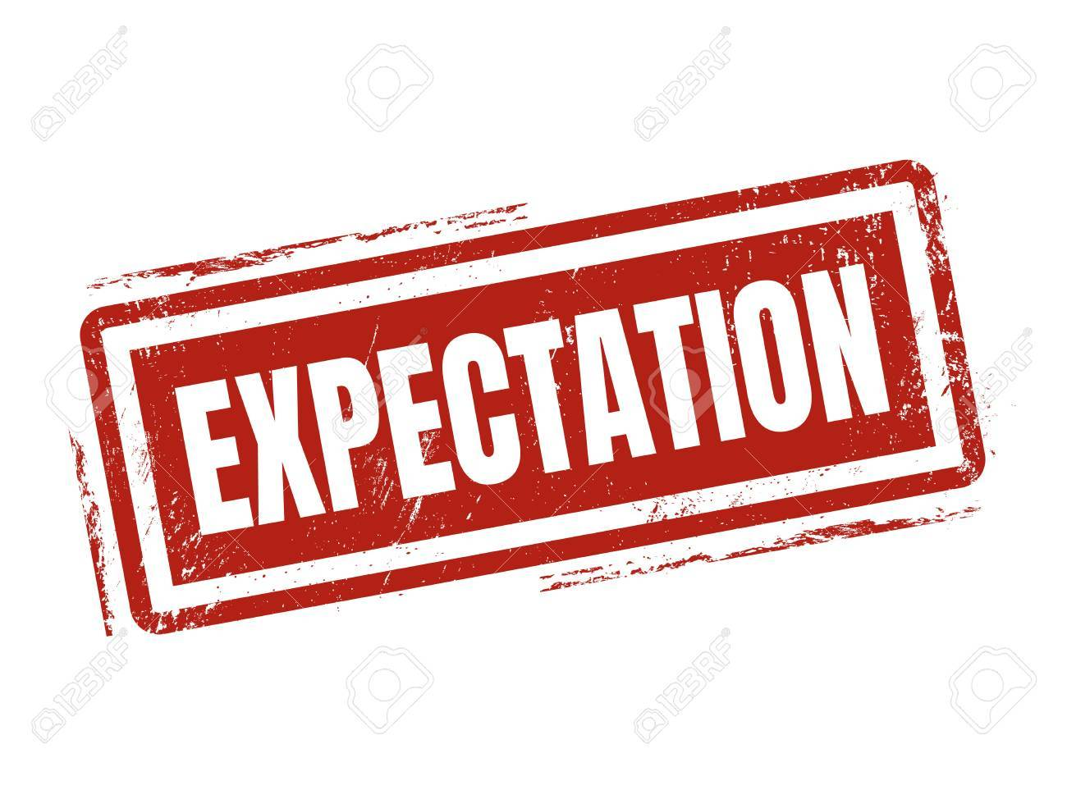
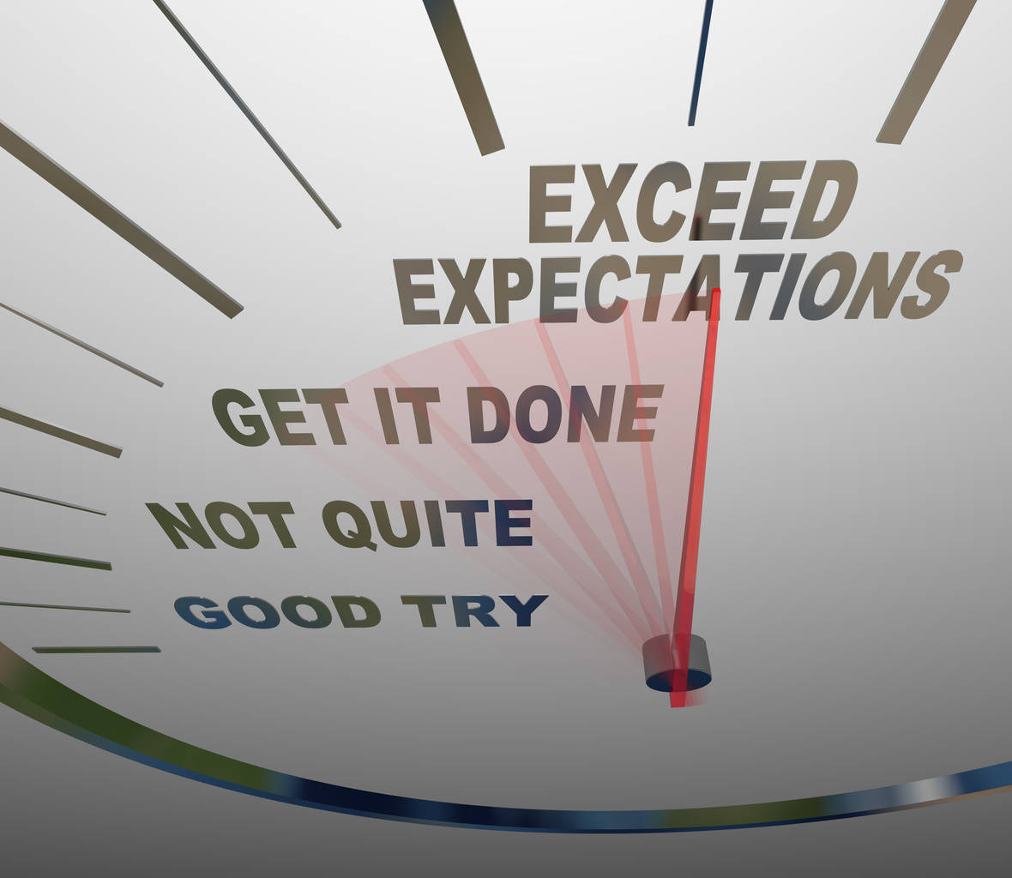
Basic Gap Between
“Don’t Compare yourself with anyone in the World If you compare , you are insulting yourself”
“ Current Practice & Expectations “
Md. Abu Tarek, Edison Group

Slide 2
Communication “Mail”
Current Practice
Expectation
Not attentive in official E-mail check back
Missing in time feedback in mail
Missing chain mail during communication for some important issues.
Missing Market & Product feedback in mail
Carefully Checking of all official mail
Right understanding of message, Effective dissemination of communication.
In time giving professional feedback to concern end.
Maintaining the chain mail and keeping the proper documentation for future reference

Slide 3
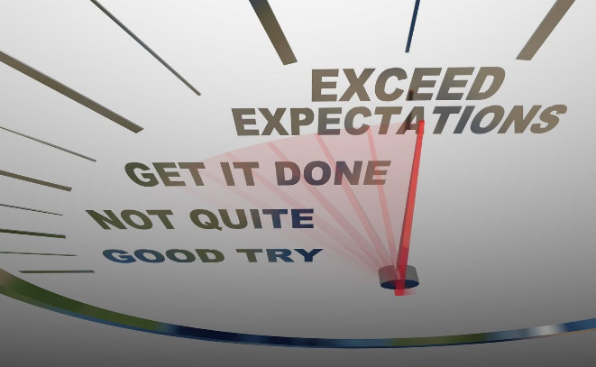
Daily Task
Current Practice
Expectation
Avoiding dealer alarming stocks during requisition
Provided disparity of DSR TGT
Absent of daily TGT vs. Ach follow up
Absent of daily sales entry, dealers actual physical stock/ market credit cross check.
Regular follow up of channel performance.
ERMS Checking and follow up to channel
Market visit
Dealer should have optimum stock of all model depending on company warehouse stock.
To avoid DSR achievement variance ZSM should be logical during target split.
Daily winning attitude is required at all level of sales team
Daily entry of IMEI, Channel credit, cross checking of physical stock with system stock is expected
Regular Follow up of EO, SIS, Big GO, SBC is mandatory.
Regular follow up DSR, Dealer with zonal placement, focus retail achievement follow up Is mandatory.
Effective MKT visit & update sharing

Slide 4
Company Policy
Current Practice
Expectation
Not maintaining office time properly
Some aren’t maintaining regular check in and check out in PMS/e-attendance
Submitting fake Travel/ holiday bill
Delay submission of TA/DA bill.
Not follow proper DM guideline
Not maintain office policy like DOA/DAP/Missing claim & others issues.
Breach of company policy is serious offence so maintain it at any circumstances

Slide 5

Excellence of Your Performance
Proactively take initiatives (result oriented)
Maintain the market visit according to your tour plan & ensure quality MKT Visit through effective coverage.
Focus on product placement and repeat placement.
Be logical in company investment ( SBC, CO retail & etc.)
Be enriched in competitors product knowledge (Segment Wise)
Proactively informed to Management your areas development plan and development plan.

Slide 6
Queries…????
“To wish was to hope, and to hope was to expect”
THANK YOU….

